Slide 1
.NET
An “Application Development Platform”.
It is developed by Microsoft Corporation in the year 2000.
.NET Stands for Network Enabled Technology.
.NET is a Package or SDK or Framework also called as ".NET Framework".
Used for powerful software application development.
It provides necessary environment (IDEs, compilers, run time engines, libraries) for developing efficient and powerful applications for the end-users.
.NET provides a distributed object oriented platform for building
Stand-alone Applications(Console & Winforms)
Web-based Applications
Service Applications
Mobile Applications

Slide 2
.NET FRAMEWORK
.NET Framework requires to run and develop any .NET Application
.NET Framework is a set of components, which are essential for develop and run any application in .NET Environment.
.NET Framework is a common Architecture for all .NET Applications.
.NET Framework Consist of following Components.
Languages
Technologies
Base Class Libraries
CLR[Common Language Runtime]

Slide 3
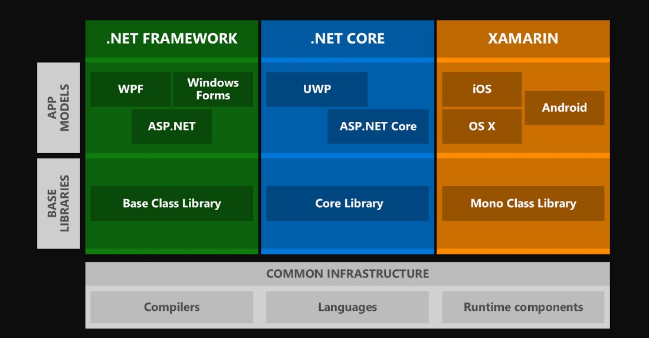
.NET Framework Architecture

Slide 4
.NET Framework Architecture
C#.NET
VB.NET
VC++
F#.Net
Win Forms,WPF
Web Forms(Asp.Net ,Asp.net MVC
Services(WCF,WEB API)
…..
ADO.NET,EntityFramework
.NET Framework
Base Class Library
Common Language Runtime
Operating System

Slide 5
Languages
.NET gives choice of languages includes VB.NET, C#, F#, VC++ for developing diff kind on Applications. All of these compile to a Common Intermediate language.
MSIL stands for Microsoft Intermediate Language.
On compiling any .NET language, you will get MSIL.
Ex: C#.NET MSIL
Ex: VB.NET MSIL
MSIL is a compile code of any .NET Language.
Also Called as Common Intermediate Language or Managed Code.
Its file extension can be either ".exe" or ".dll".
EXE file are directly executable files.
A DLL file shares the common code among many projects.
CSC
VBC

Slide 6
MSIL
MSIL stands for Microsoft Intermediate Language.
On compiling any .NET language, you will get MSIL.
Ex: C#.NET MSIL
Ex: VB.NET MSIL
Ex: VC++.NET MSIL
MSIL is a compile code of any .NET Language.
Also Called as Common Intermediate Language or Managed Code.
MSIL code will be saved in a file called "Assembly".
Its file extension can be either ".exe" or ".dll".
EXE file are directly executable files.
A DLL file shares the common code among many projects.
CSC
VBC
VCC

Slide 7
CLR
Common Language Runtime is the core component for .NET framework
CLR is Common Runtime Engine for all .NET Applications
All the .NET program execution is managed by CLR.
CLR uses Just-In-Time (JIT) compiler to compile CIL code into the machine understandable code(Native code).
.cs/.vb
CSC/VBC
MSIL
CLR
Native Code

Slide 8
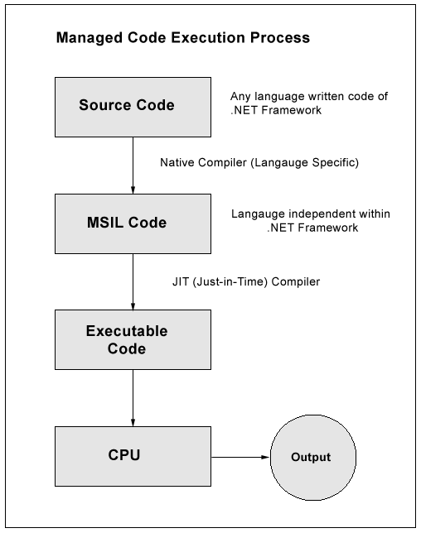
Execution Process

Slide 9
Common Runtime Engine and CIL(Compilation Model)
.NET compilation model
VB.NET.C#/J#/C++ Code
.NET compatible languages compile to a platform-neutral language called Common Intermediate Language(CIL)
Compiler
Common Intermediate Language
The platform-specific CLR compiles CIL to machine-readable code that can be executed on the current platform
Common Language Runtime
01101100101011
10010101100110

Slide 10
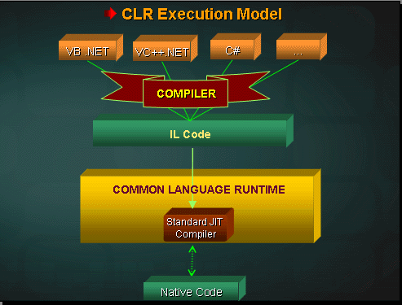

Slide 11
Base Class Libraries
Base Class Libraries are Standard Libraries common to all .NET languages.
Base Class Libraries are Predefined Libraries comes with .NET framework
Base Class Libraries provides some set of Common classes , which are useful for development of .NET applications.
All Base class Libraries are in the form of .dll(dynamic link libraries)
The Base class Libraries also called Assemblies or Namespaces.

Slide 12
Base Class Libraries
Important DLL files of BCL
System.IO
System.Threading
System.Data
System. Web
System.Web.MVC
Microsoft.AspNetCore
Note: System is the Base Library in .Net Framework.
Adding a Library to the Application
using System. Web----------C#
Imports System.Web----------VB.net

Slide 13
Core Features of .NET Framework
Language Independence
Multi Application Support
Multi Server Support
Database Server(SQLSERVER , Oracle, MySQL)
Web Server(IIS)
Azure Server
CLR to All the Languages.
Common Intermediate Language CIL(MSIL)
Base Class Library
Interoperability
Data Access
Web Application Development and Deployment
Security
Memory Management

Slide 14
Multi Server Support
Microsoft SQL Server-- data storage
IIS(web server)-- A web server for asp.net app
Mobile ISS--A web server for mobile app

Slide 15
Interoperability
it represents cross language integration
which means develop logic in one language and used in other Lang
.NET support interoperability with .NET Lang and other .NET lang.

Slide 16
Data Access with ADO.NET
ADO is ActiveX Data Objects
This library provides a set of classes that provide data access services to access data from relational database , XML and application data.
Entity Framework which supports Entity Data Model (EDM), LINQ TO SQL to communicate with SQL SERVER etc.

Slide 17
ASP.NET
Active Server Pages.
ASP.NET is a web application framework to build dynamic web sites, web applications and web services .
It is a successor to Microsoft's Active Server Pages (ASP) technology.
Uses IIS as application server
IIS
ASP.NET Page
Web Services
HTML Page
Web page Request
HTML Response
HTTP/HTTPS
HTML Response
Client
Web service Request
SOAP Response

Slide 18
Memory Management
The .NET provides automatic Garbage Collection mechanism where by the unreferenced memory that was allocated by the code dynamically is freed automatically.

Slide 19
Visual Studio
IDE for creating .NET applications which are
Console based
Web based
Windows form based
Web services
Features
Page design
Automatic error detection
Debugging tools
IntelliSense (IntelliSense helps in auto completion by providing functions/methods names parameters etc.)
.

Slide 20
Visual Studio
Visual Studio 6.0
Visual Studio .NET (2002)
Visual Studio .NET 2003
Visual Studio 2005
Visual Studio 2008
Visual Studio 2010
Visual Studio 2012
Visual Studio 2013
Visual Studio 2015
Visual Studio 2017
Visual Studio 2019

Slide 21
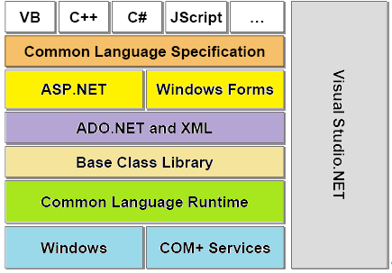

Slide 22
.NET framework versions
.NET 1.0
Visual Studio .NET 2003
Windows Server 2003
.NET 2.0
Visual Studio .NET 2005
Windows Server 2003 R
.NET 3.0
Visual Studio .NET 2005
Windows Vista, Windows Server 2008
.NET 3.5
Visual Studio 2008
Windows 7, Windows Server 2008 R2
.NET 4.0
Visual Studio 2010
Windows 7(Recommended)
.NET 4.5
Visual Studio 2012
Windows 7,8, Windows Server 8
.NET 1.1
Visual Studio .NET
Windows XP tablet and Media center

Slide 23
.NET Framework (4.0)
MVC
TPL
Parallel LINQ
AJAX-enabled Web sites
LINQ
EF
WCF
WPF
WF
4.0
ADO.NET
ASP.NET
WinForm
3.5
3.0
Base Class Libraries
2.0
Common Language Runtime

Slide 24
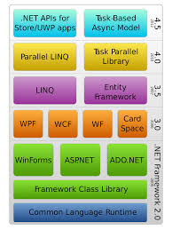
Notes:
Universal Windows Platform (UWP) apps - MSDN - Microsoft

Slide 25
.NET Framework stack
WCF: Windows Communication Foundation (WCF) is a framework for building service-oriented applications.
WPF: Windows Presentation Foundation (WPF) is a framework for building rich UI, media, and documents.
WF : Windows Workflow Foundation is a framework for building workflow application.
AJAX-enabled Web sites: Websites that uses Asynchronous JavaScript and XML (AJAX) that allows features like partial page updates and asynchronous loading.
LINQ: Language Integrated Query provides unified querying capability across different data sources like SQL databases, XML documents, various Web services, objects.
EF: The Entity Framework is a ORM library for communicating backend data bases.
MVC:MVC stands for model-view-controller. MVC is a pattern for developing applications that are well architected and easy to maintain.

Slide 26
Environment Setup
Windows Platform(Windows 10)
Visual Studio.NET(2019)
SQL Server 2014
Web Server(IIS)(Internet Information Service)

